Slide 1
Department of Computer Science
&
Applications
OPEN COURSE

Slide 2
INTRODUCTION TO COMPUTERS
&
OFFICE AUTOMATION

Slide 3
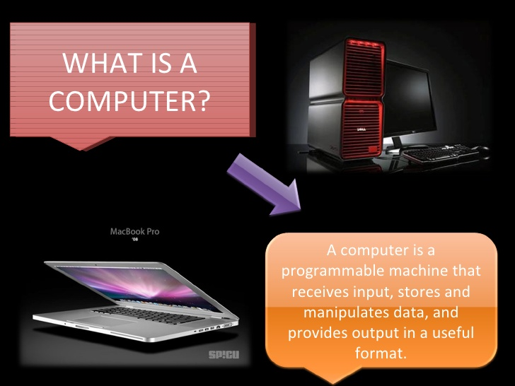

Slide 4
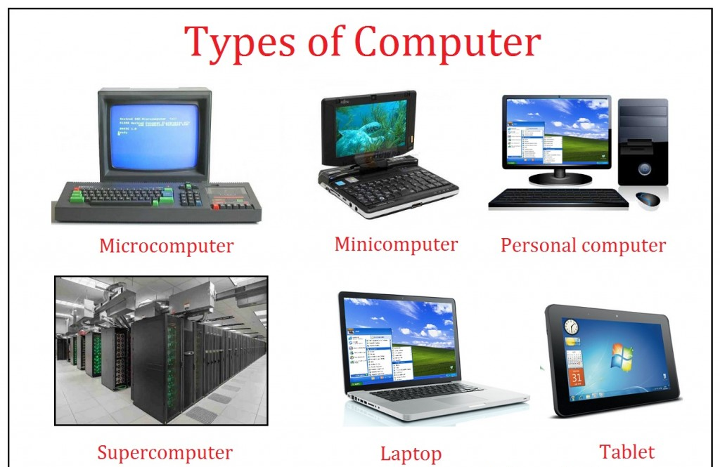

Slide 5
OFFICE AUTOMATION

Slide 6

MICROSOFT WORD
It is the word processing program of the Microsoft Office suite that allows you to create documents and reports.

Slide 7
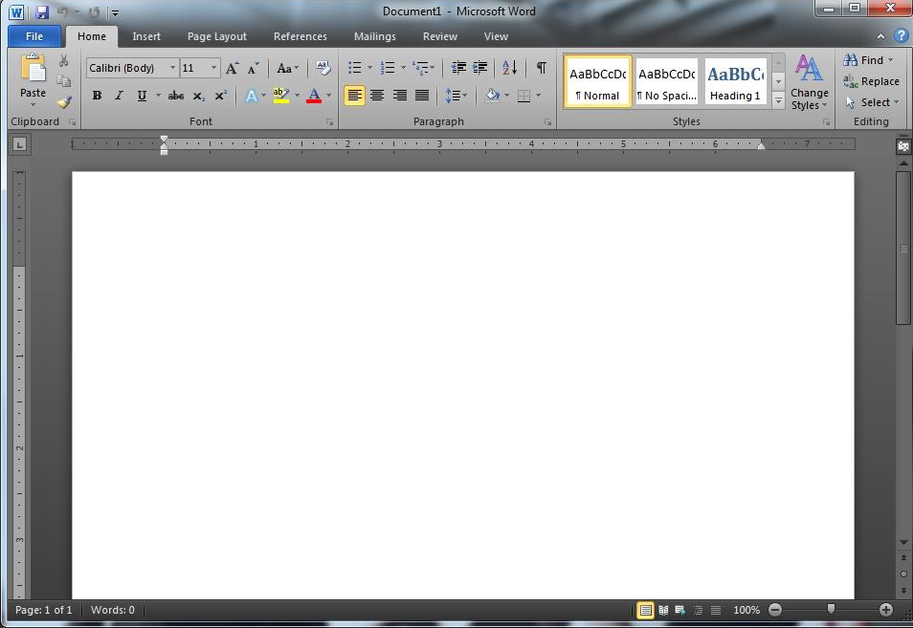
Microsoft Word 2010 Main Screen

Slide 8
Microsoft Word is excellent for creating different documents on your computer!
Text Formatting
TABLES
GRAPHICS

Slide 9
Let’s say you have an essay to write…
Open your Microsoft Word
You start typing away… Words become sentences, sentences turn into paragraphs… And the formatting begins…
ABCDEFGHIJKLMNOPQRSTUVWXYZ

Slide 10

You can use different formatting tools when creating the following:
Project Papers
Class Newspapers
Resumes

Slide 11

Whatever you type, just remember to always check spelling

Slide 12
You can also create tables in
MS Word

Slide 13

You could also insert pictures, photos and clip art into your documents…

Slide 14


You can transfer photos from your camera directly into your MS Word pages:

Slide 15


Microsoft EXCEL

Slide 16
What is Microsoft Excel?
Microsoft Excel is a
spreadsheet application
written and distributed by the company
Microsoft.

Slide 17
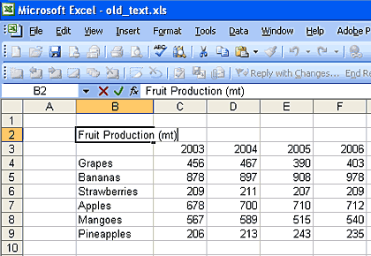
What is an Excel spreadsheet?
A grid of rows and columns containing numbers, text, and formulas.

Slide 18
What is the purpose of using Excel?
The purpose of a spreadsheet is to
solve problems with numbers
(without using a calculator)!

Slide 19

How Can You Use Excel?
You can use Excel spreadsheets to……

Slide 20
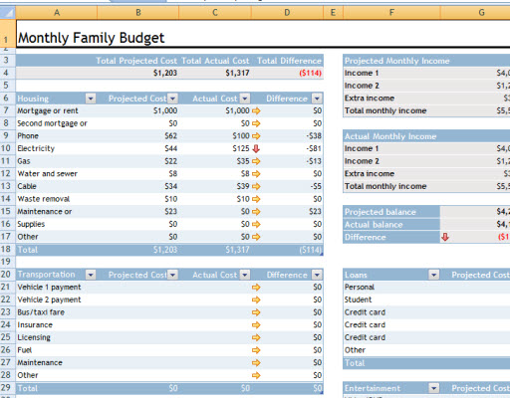
Budgets
http://www.computer-programming-for-beginners.com/images/Excel-Budget-Template.jpg

Slide 21
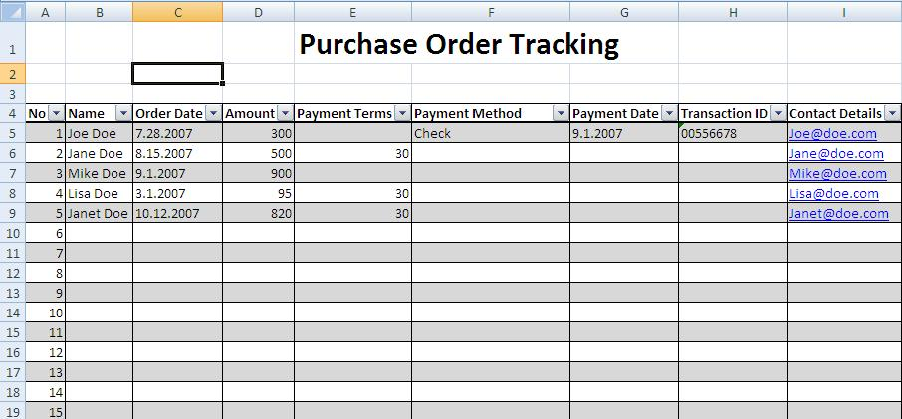
Purchase Orders
Notes:
To keep track of purchase orders for a business.

Slide 22
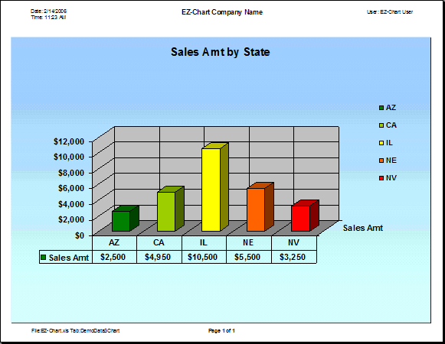
Charts and diagrams
Notes:
To create charts that allow you to easily analyze data.

Slide 23
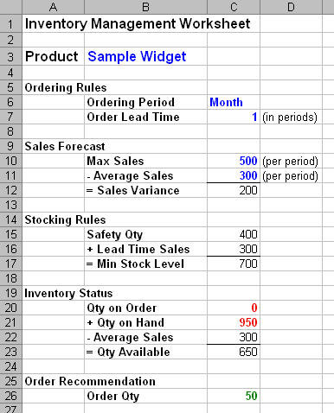
Keep Track of Inventory
Notes:
To keep track of your businesse’s inventory so that you can analyze how much of a product that you have and how much you need to order.

Slide 24
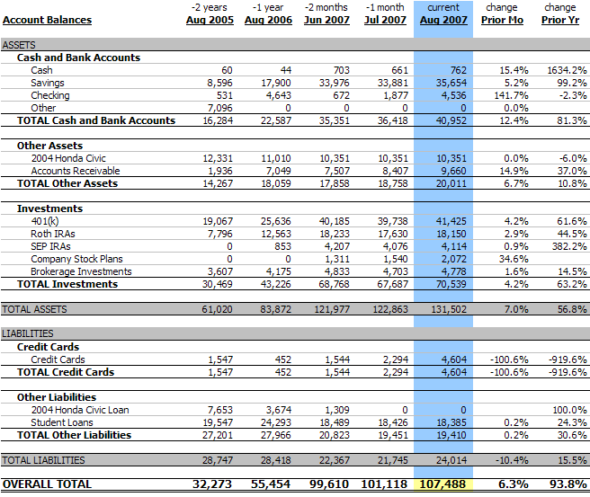
Financial Statements
Notes:
Professionals such as accountants can use an excel spreadsheet to keep track of company assets and liabilities.

Slide 25

Microsoft Power Point
Using PowerPoint to Design Effective Presentations

Slide 26


